Slide 1

WELCOME TO MY
PRESENTATION
A Presentation on Evaluation of Central Pharmaceuticals Working Capital Management
Department of Finance and Banking
University Of Barishal

Slide 2


Evaluation of Central Pharmaceuticals Working Capital Management

Slide 3
Executive Summary
The Presentation attempts to evaluate the Renata Central Pharmaceuticals’s Working Capital Management. Central Pharmaceuticals is one of the top ten pharmaceutical manufacturers in Bangladesh. Renata is engaged in the manufacture and marketing of human pharmaceutical and animal’s health products.. Ratio Analysis System has been followed to evaluate the Central Pharmaceuticals’s Working Capital Management.

Slide 4
Overview
In this presentation we will discuss on the following objectives :
Financial Analysis with Ratio
SWOT Analysis of Renata Central Pharmaceuticals
Conclusion & Recommendation

Slide 5

Financial Analysis
Net Working Capital :
Year | 12-13 | 13-14 | 14-15 | 15-16 | 16-17 | 17-18 | 18-19 | 19-20 | 20-21 | 21-22
Net Working Capital (in Million) | $45.50 | $38.58 | $85.63 | $88.57 | $90.66 | $92.40 | $33.19 | $54.46 | $77.24 | $92.51

Slide 6
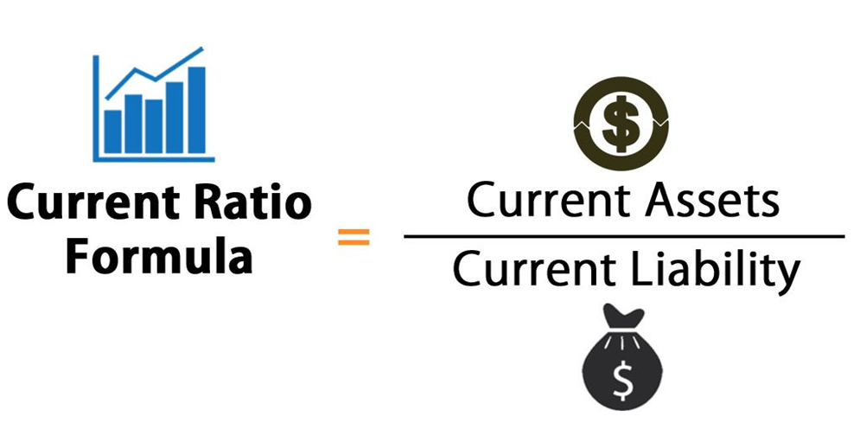
Current Ratio:
Year | 12-13 | 13-14 | 14-15 | 15-16 | 16-17 | 17-18 | 18-19 | 19-20 | 20-21 | 21-22
Current Ratio | 1.113 | 0.72 | 1.09 | 0.78 | 1.02 | 1.38 | 1.75 | 2.22 | 2.67 | 2.53

Slide 7
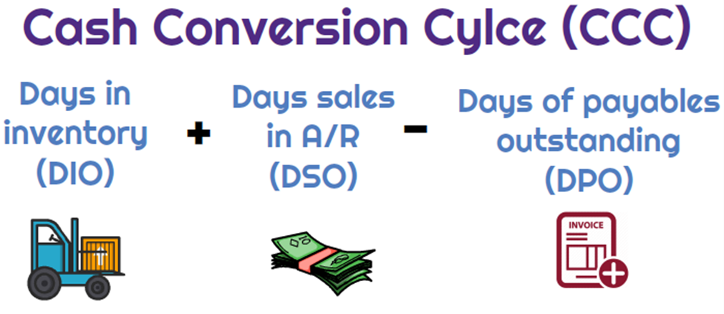
Cash Conversion Cycle:
Year | 12-13 | 13-14 | 14-15 | 15-16 | 16-17 | 17-18 | 18-19 | 19-20 | 20-21 | 21-22
Cash Conversion Cycle | 32.09 | 31.89 | 37.30 | 43.76 | 56.87 | 45.00 | 45.40 | 45.11 | 37.22 | 38.42

Slide 8
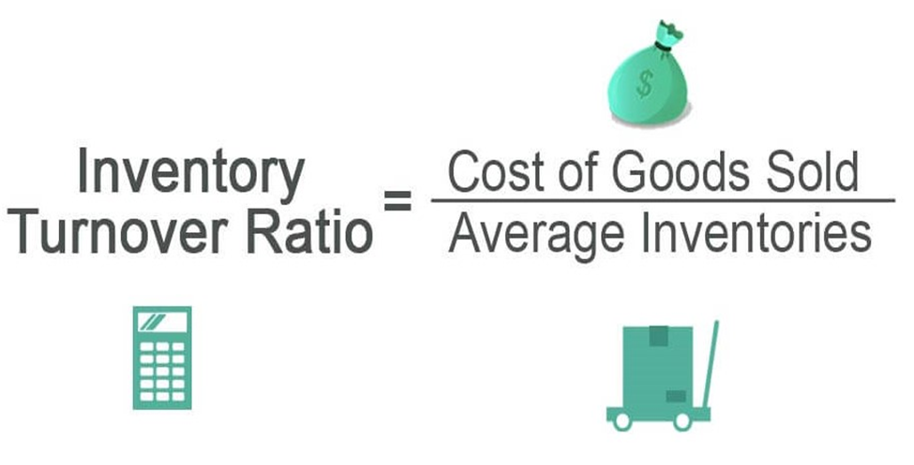
Inventory turnover Ratio:
Year | 12-13 | 13-14 | 14-15 | 15-16 | 16-17 | 17-18 | 18-19 | 19-20 | 20-21 | 21-22
Inventory turnover Ratio | 1.85 | 1.96 | 1.82 | 1.62 | 1.96 | 2.07 | 2.41 | 2.65 | 2.79 | 2.72

Slide 9
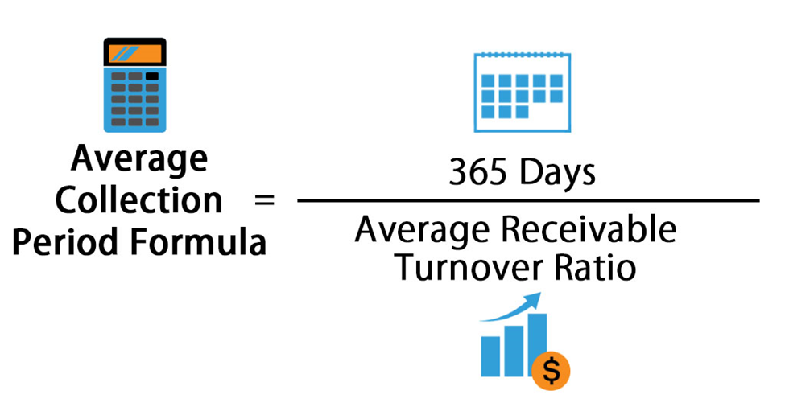
Average collection period :
Year | 12-13 | 13-14 | 14-15 | 15-16 | 16-17 | 17-18 | 18-19 | 19-20 | 20-21 | 21-22
Average collection period | 39.56 | 46.97 | 43.22 | 48.93 | 51.44 | 45.00 | 45.40 | 45.11 | 37.22 | 38.41

Slide 10
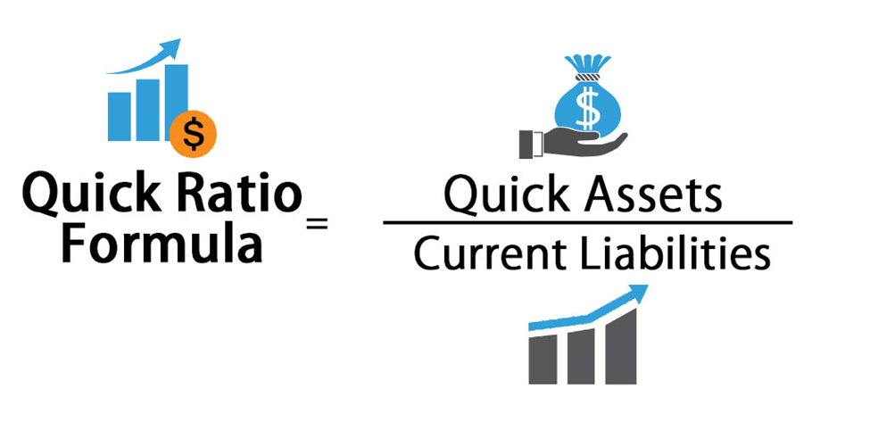
Quick Ratio :
Year | 12-13 | 13-14 | 14-15 | 15-16 | 16-17 | 17-18 | 18-19 | 19-20 | 20-21 | 21-22
Quick Ratio | 0.42 | 0.26 | 0.44 | 0.29 | 0.49 | 0.55 | 1.02 | 1.38 | 1.77 | 1.68

Slide 11
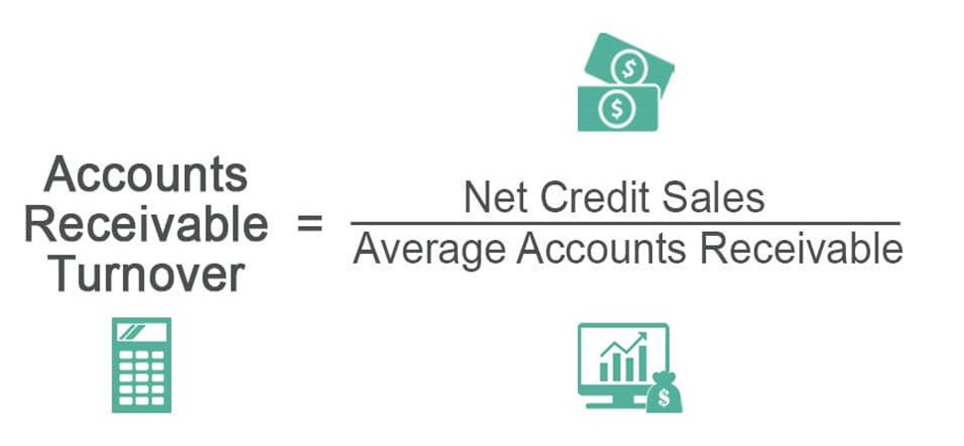
Account Receivable turnover:
Year | 12-13 | 13-14 | 14-15 | 15-16 | 16-17 | 17-18 | 18-19 | 19-20 | 20-21 | 21-22
Account Receivable turnover | 9.09 | 7.66 | 8.19 | 7.35 | 6.99 | 8.11 | 8.04 | 8.33 | 9.81 | 9.50

Slide 12

SWOT Analysis of Renata Central Pharmaceuticals

Slide 13

Strengths of Central Pharmaceuticals.:
Weakness of Central Pharmaceuticals.:
Ability to cope with the change
Attractive pay package
Experienced management team
Modern technology
Innovative product line
Short of marketing expertise
Lacking accountability.
Lack of employe
Delay in payment from supplier
Location of the factory.
Opportunities of Central Pharmaceuticals.:
Thereat to Central Pharmaceuticals.:
Developing market area
Can lead against weak competitor
Scope of expansion on of business
Can give extra facility to gain customers satisfaction.
Government tax and vat structure.
Lots of Competitor
Trade barriers
Skilled employee switching
Strike (Hartal)

Slide 14
Conclusions & Recommendation
Conclusions:
Here are some main key points of Conclusion of Central Pharmaceuticals.:
Good current ratio
Increasing quick ratio
Consistent inventory turnover ratio
Inconsistent Cash Conversion Cycle
Good net working capital

Slide 15
Recommendation:
Here are some main key points of Recommendation of Central Pharmaceuticals.:
Identify the market segmentation
Must try to understand the buyer buying behavior
Need to develop relationship with parties
Need to establish effective marketing strategy
Should implement data based marketing
Survey on buyer intentions

Slide 16
Thank You

